Slide 1
ANALYSIS OF CLIMATE DATA ACROSS 50 WEATHER STATIONS IN MINNESOTA
BY
ISAIAH T. OCANSEY & IRENE ODOI

Slide 2
INTRODUCTION
Climate data collected by weather stations in Minnesota provides valuable information for a wide range of applications, including agriculture, urban planning, disaster preparedness, and environmental research. Understanding Minnesota's climate is essential for residents, policymakers, and industries to adapt to changing weather patterns and mitigate the impacts of climate-related risks and hazards.

Slide 3
Objective of the Study
Analyze historical weather data, including Average monthly temperature, Snow precipitation and Evaporation from the selected weather stations.
Identify trends and patterns in weather variables across different geographical locations within Minnesota.
Assess the variability and distribution of weather phenomena, such as extreme weather events and seasonal changes

Slide 4
DESCRIPTIVE ANALYSIS
DATA
Data source: https://www.ncdc.noaa.gov/cdoweb/search?datasetid=PRECIP_HLY# https://www.ncdc.noaa.gov/cdo-web/customoptions
Selected data contains 10 year climate historic data from July 1, 2013 to July 31, 2023 across 50 weather stations in Minnesota.
Dimension: The data has 4231 observations 150 variables (i.e . including variables and their attributes)

Slide 5
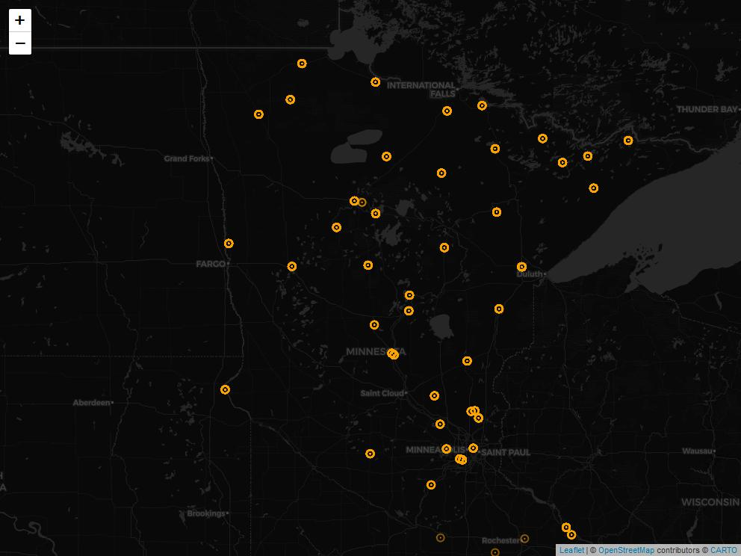
Weather Stations in Minnesota

Slide 6

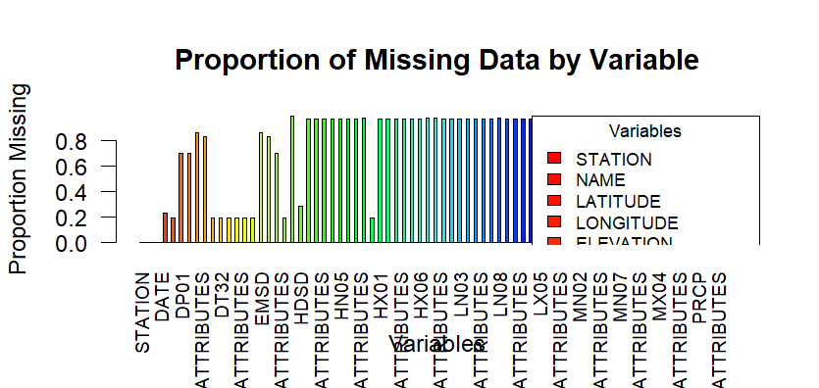
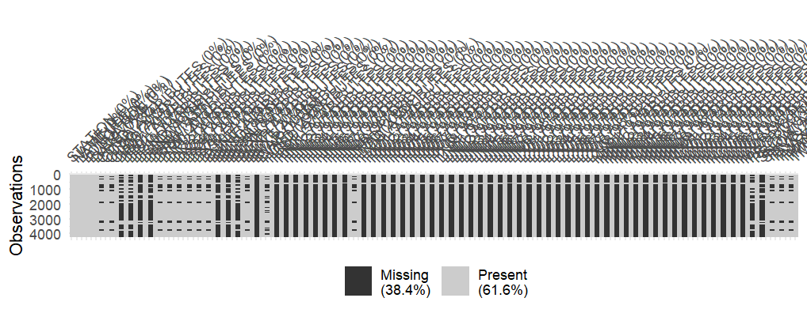
MISSING VALUES

Slide 7
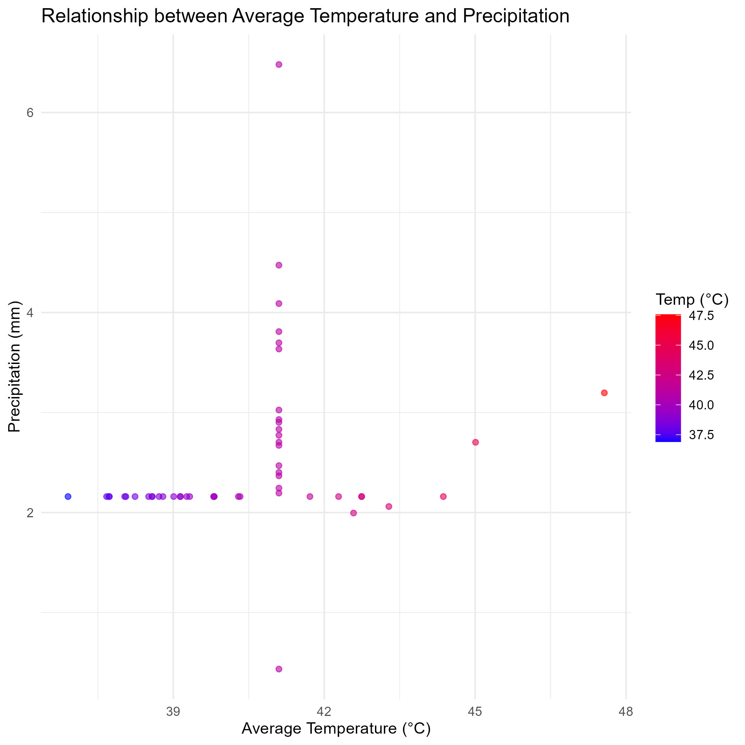
BIVARIATE ANALYSIS

Slide 8
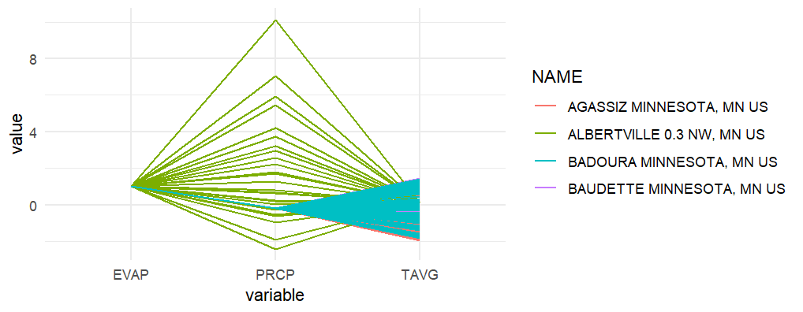
Multivariate analysis

Slide 9
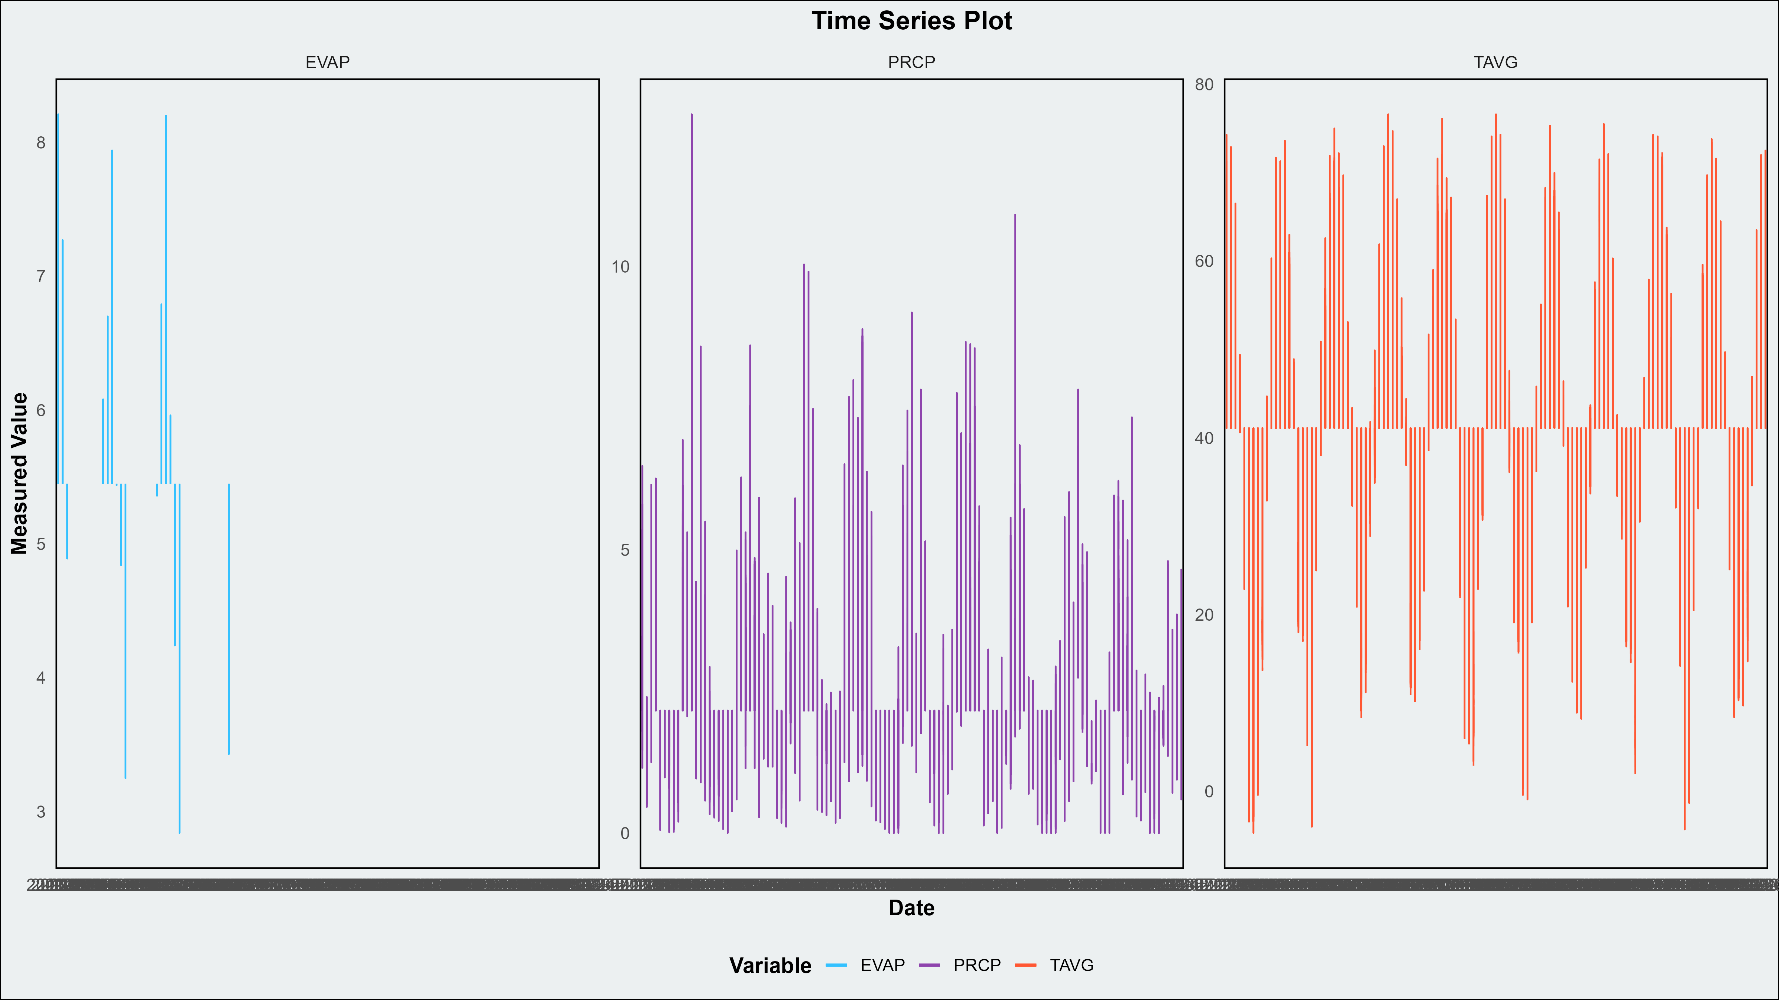
Time Series plot

Slide 10
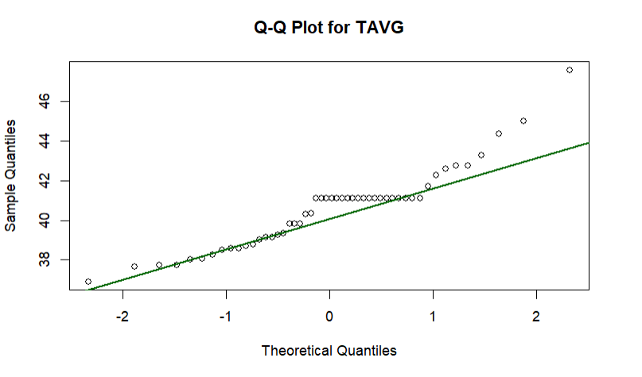
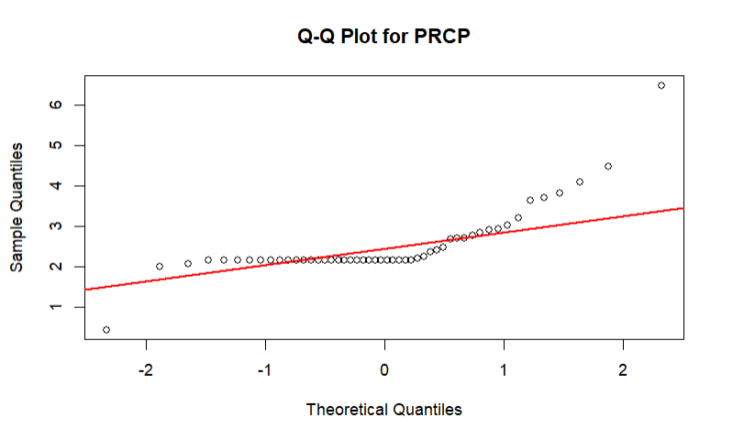
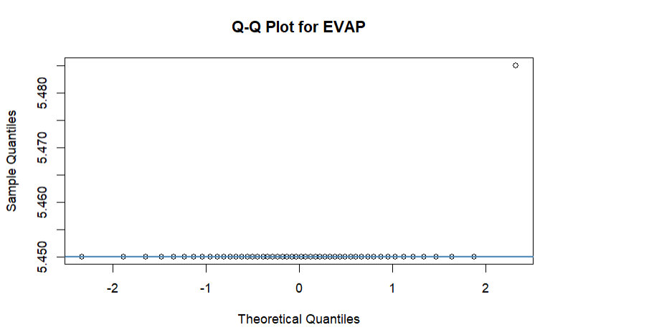
Normality Test

Slide 11
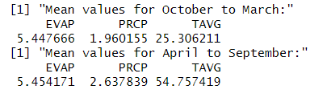
HYPOTHESIS TESTING
Group 1: mean vector of October-March
Group 2: mean vector of April- September.
Ho: group 1 = group 2
H1: group 1 ≠ group 2
Test Statistic: 6325.4
Degrees of freedom: 3
n: 4227
P-Value: 0

Slide 12
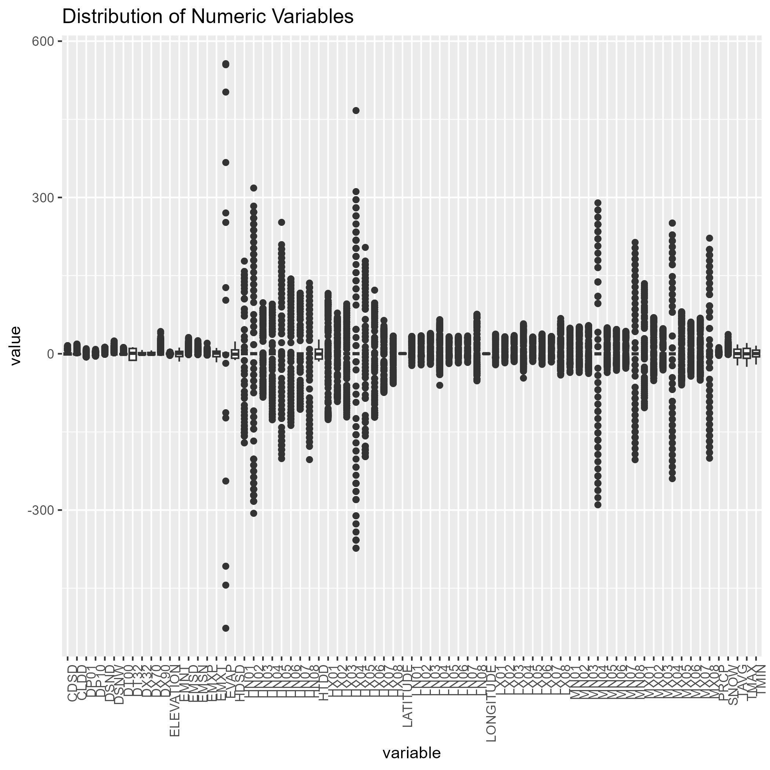
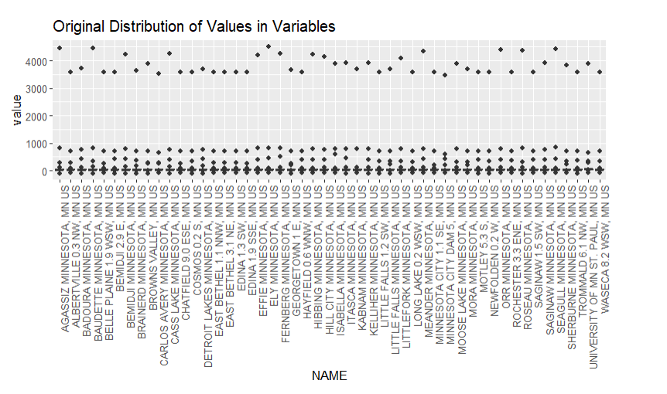
Original Distribution vrs Distribution after Standardization

Slide 13
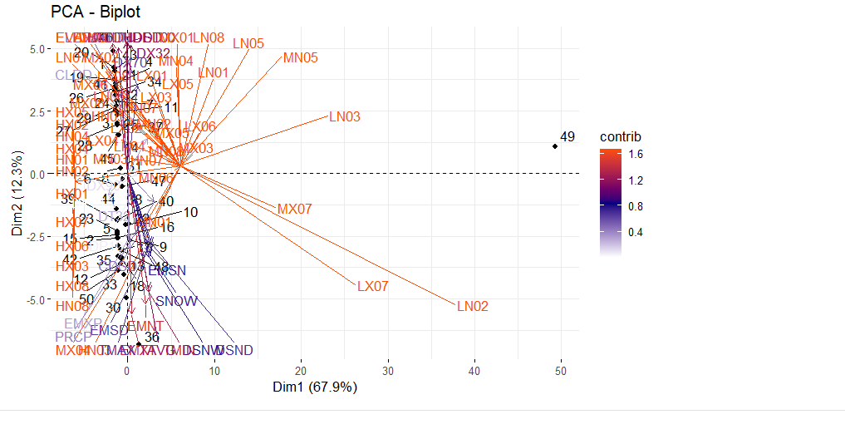
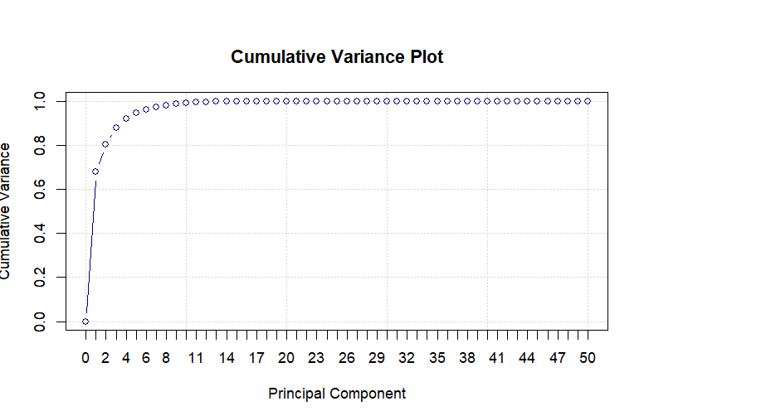
PRINCIPAL COMPONENT ANALYSIS (PCA)

Slide 14
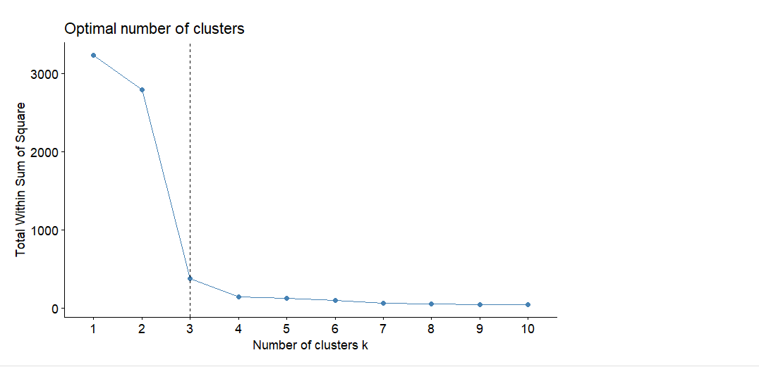
K-MEANS CLUSTERING

Slide 15
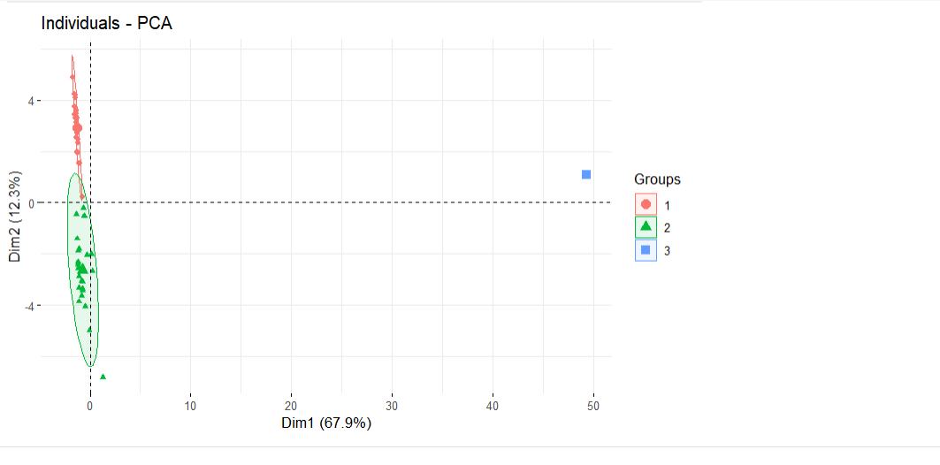
K-MEANS CLUSTERING BASED ON PCA

Slide 16
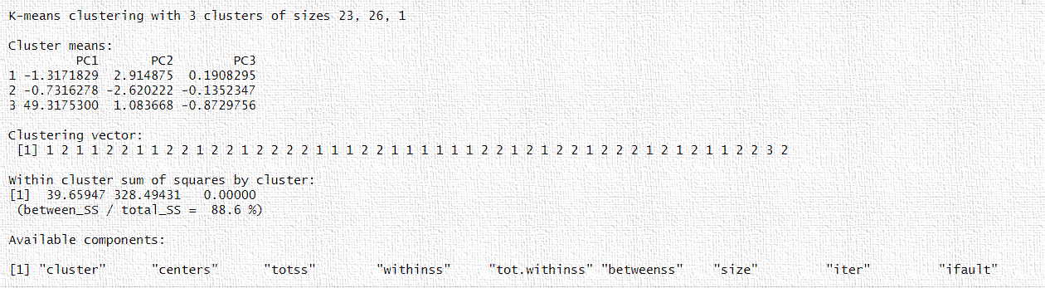
K-MEANS CLUSTERING BASED ON PCA

Slide 17
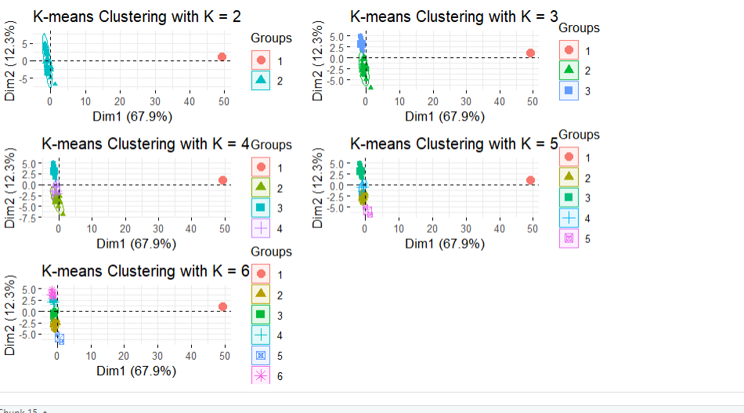
K-MEANS CLUSTERING FOR MORE THAN 3 CLUSTERS

Slide 18
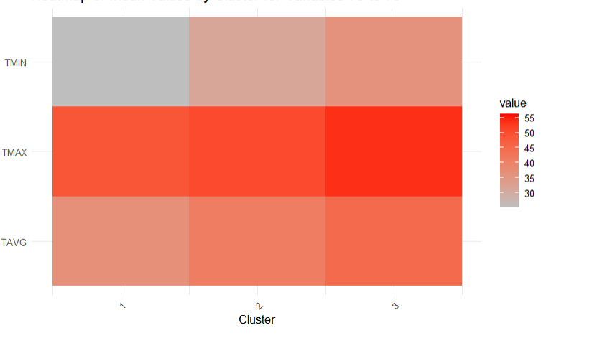
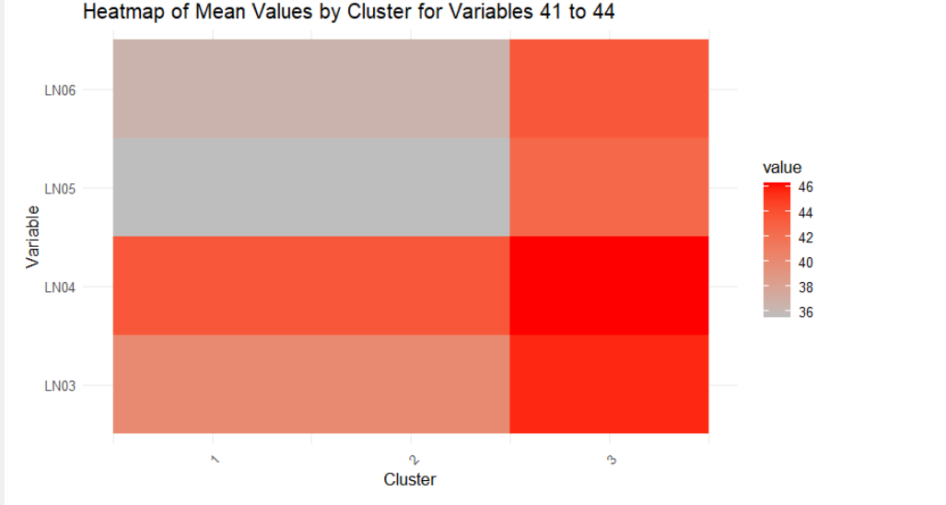
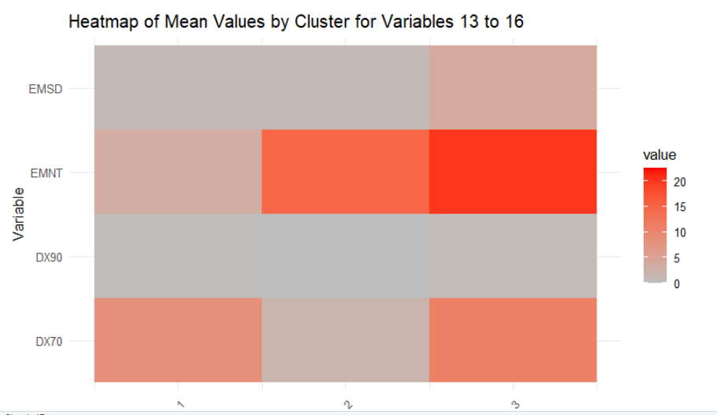
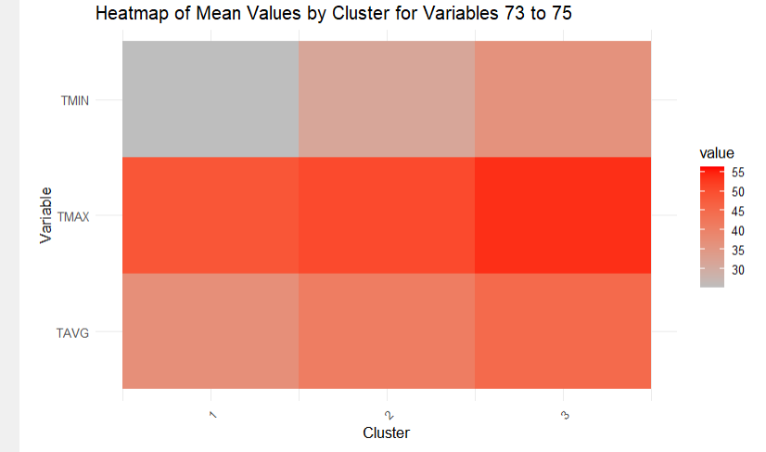
HEATMAPS FOR SELECTED VARIABLE

Slide 19
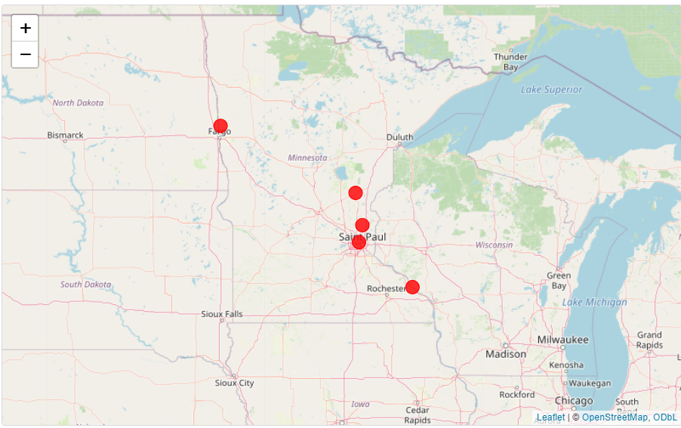

Slide 20

THANK YOU!!!

